Slide 1
Consolidated Fellowship and Assemblies Attire
Anointed Remnant Global Assemblies
Forwarded by: Bishop Dr. Willie L. Bradley

Slide 2
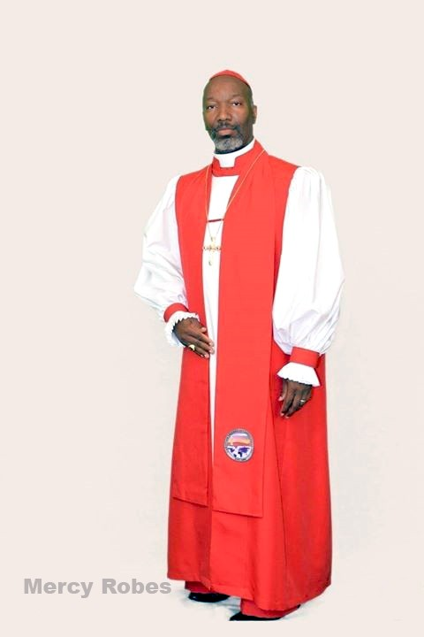
Bishop Attire:
Position #1. – Presiding Bishop and or Presiding Apostle
Garment – Bishop Vestment
Color – Red & White
Cord – Bishop’s Braided Red & White

Slide 3
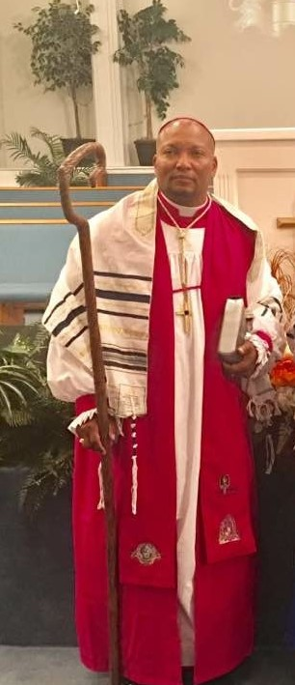
Bishop Attire:
Position #1. – Senior Executive Overseeing Bishop
Garment – Bishop Vestment
Color – Fuchsia & White
Cord – Bishop’s Braided Fuchsia, & White or Gold White

Slide 4
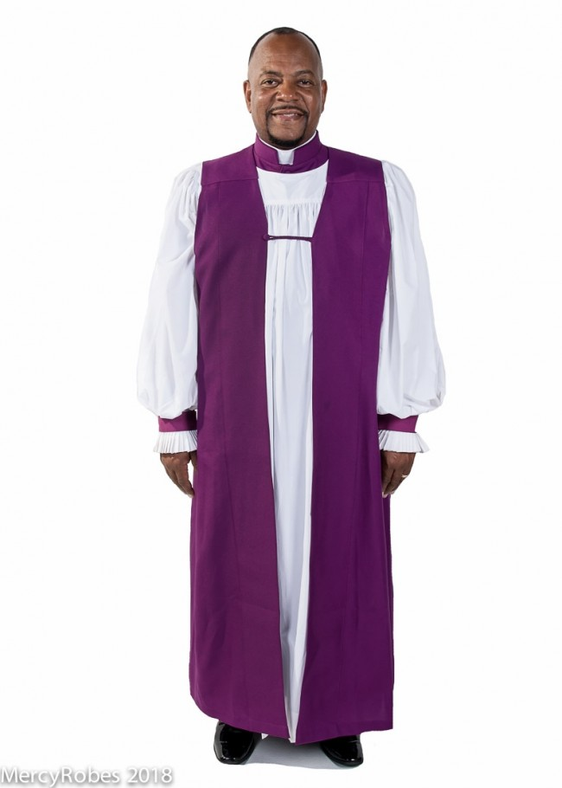
Bishop Attire:
Position #3. – Administrative Staff Bishop
Garment – Bishop Vestment
Color – Purple & White
Cord – Bishop’s Braided Purple & Gold

Slide 5
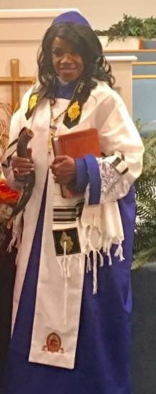
Apostle Attire:
Position. – Administrative Apostle
Garment – Apostle Vestment w/Overseer Rochet w/lace female (male no lace), w/red zucchetto
Color – Red & White
Cord – Bishop’s Braided Red, White or w/Gold
This is a red and white garment

Slide 6
Prophetess/Prophet Attire:
Position #1. – Senior International Prophetess
Garment – Prophetess Vestment w/Overseer Rochet w/lace female (male no lace), w/blue zucchetto
Color – Blue & White
Cord – Prophetess Braided Blue, White or w/Gold

Slide 7
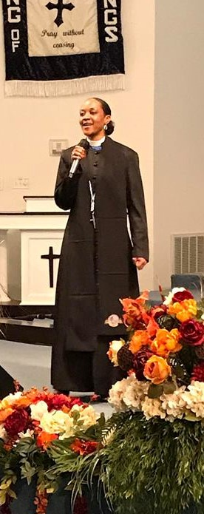
Senior Overseer, Prophet or Prophetess Attire:
Position. – Senior Overseer, Prophet or Prophetess
Garment – Garment – Overseer Vestment - Cassock (9 button female/33 button male), Blue Shirt, Full Collar, Silver Cross
Color – Blue & White
Cord – Blue & White w/Silver Cross

Slide 8
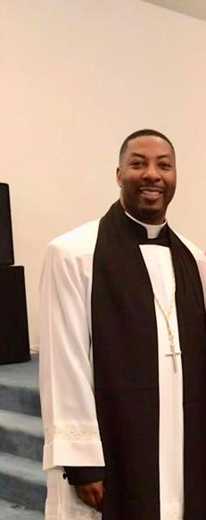
Chief Adjutant Attire:
Position. – Chief Adjutant
Garment – Surplice, Slacks, Cassock, Tippet and Full Collar
Color – Black Slacks and shoes
Cord – Applicable to Clergy Position: White for Ministers and non-licensed; Gold for Elders

Slide 9
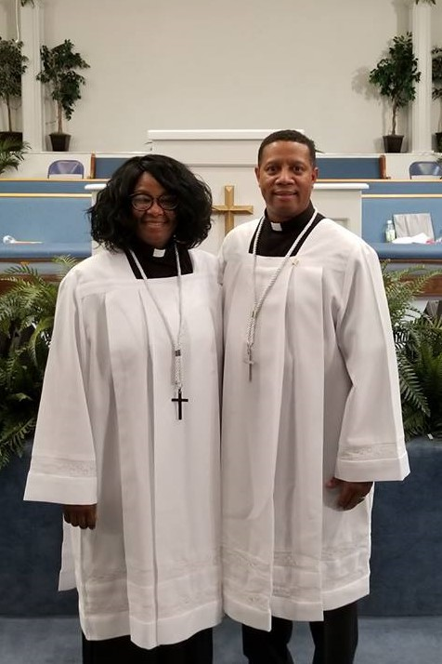
Adjutant Attire:
Position. – Adjutant
Garment – Surplice, Slacks/Skirt, Shirt/Blouse and Tab Collar
Color – Black Slacks/Skirt, Shirt/Blouse
Cord – Applicable to Clergy Position: White for Ministers and non-licensed; Gold for Elders

Slide 10

Senior Pastor Attire:
Position. – Senior Pastor
Garment – Garment – 33 Button Cassock Robe; Tippet, Black Shirt, w/Full Collar
Color – Black & White
Cord – Gold & White w/Silver Cross

Slide 11
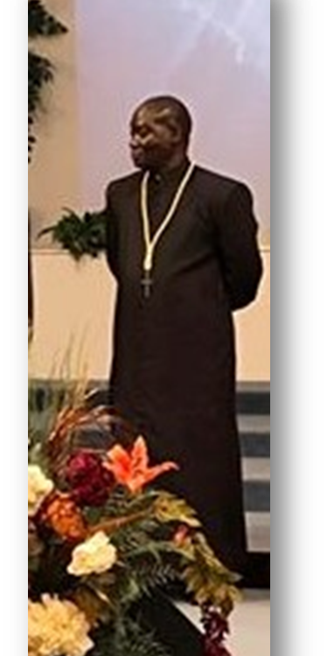
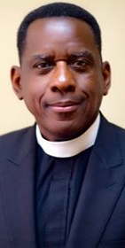
Elder Attire:
Position. Elder
Garment – Garment – 33 Button Cassock Robe; Black Shirt, w/Full Collar
Color – Black & White
Cord – Gold & White w/Silver Cross
Note: Chief Elder - Gold & White Cord (Women: Black skirt suit)

Slide 12
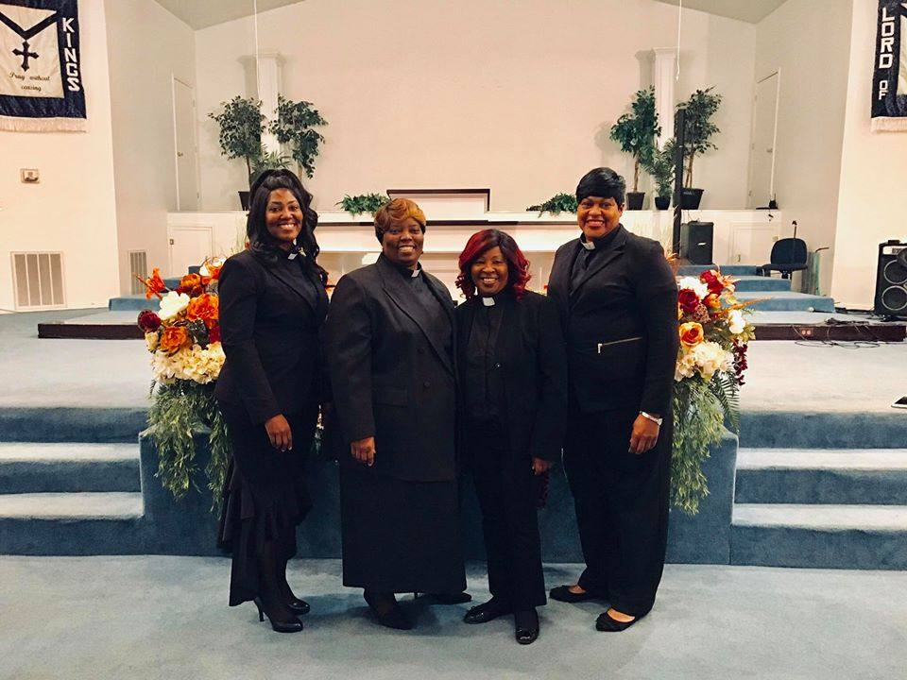
Minister Attire:
Position. Minister
Garment – Standard Suit (men), Skirt Suit (women) and Tab Collar
Color – Black & White
Cord – White w/Silver Cross

Slide 13
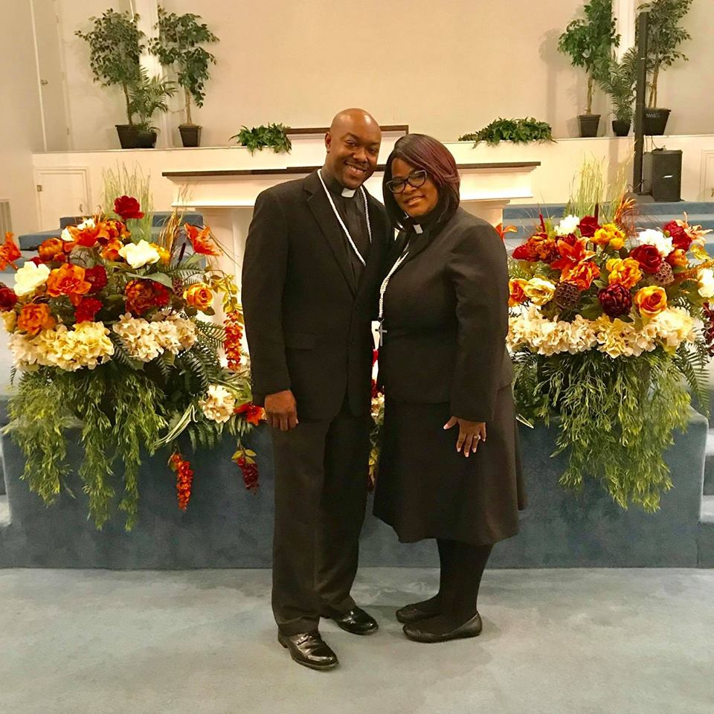
Minister in Training Attire:
Position. Minister in Training
Garment – Standard Suit, Skirt Suit women, Clergy Shirt; and no Tab in Collar
Color – Black & White
NO WHITE TAB COLLAR FOR MIT’s

Slide 14
Note: Guidelines for Tippet Placement of - Governing Fellowships/Assemblies, Seals and Birthing Organization Identification.
The Governing Fellowships/Assemblies, Seals and Birthing Organizations will be placed onto the Tippet as outlined from a facing or on-looking position.
Governing Fellowships/Assemblies Identification will be placed on the Left Side (additional historical Governing Identification will be placed up-ward)
Birthing Seals and or Identification will be placed on the Right Side (additional Birthing Identification will be placed up-ward)

Slide 15
Consolidated Fellowship and Assemblies Attire
Forwarded by: Bishop Dr. Willie L. Bradley

